Slide 1

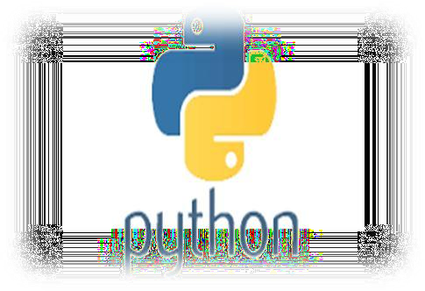

New syllabus 2020-21
Chapter 2
Functions
Computer Science
Class XII ( As per CBSE Board)

Slide 2
Function Introduction
A function is a programming block of codes which is used to perform a single, related task. It only runs when it is called. We can pass data, known as parameters, into a function. A function can return data as a result.
We have already used some python built in functions like print(),etc.But we can also create our own functions. These functions are called user-defined functions.

Slide 3
Advantages of Using functions:
Program development made easy and fast : Work can be divided among project members thus implementation can be completed fast.
Program testing becomes easy : Easy to locate and isolate a faulty function for further investigation
Code sharing becomes possible : A function may be used later by many other programs this means that a python programmer can use function written by others, instead of starting over from scratch.
Code re-usability increases : A function can be used to keep away from rewriting the same block of codes which we are going use two or more locations in a program. This is especially useful if the code involved is long or complicated.
Increases program readability : The length of the source program can be reduced by using/calling functions at appropriate places so program become more readable.
Function facilitates procedural abstraction : Once a function is written,
programmer would have to know to invoke a function only ,not its coding. 7.Functions facilitate the factoring of code : A function can be called in other function and so on…

Slide 4
Creating & calling a Function (user defined)
A function is defined using the def keyword in python.E.g. program is given below.
def my_own_function(): print("Hello from a function")
#Function block/ definition/creation
#program start here.program code
print("hello before calling a function")
my_own_function() #function calling.now function codes will be executed
print("hello after calling a function")
Save the above source code in python file and execute it

Slide 5
Variable’s Scope in function
There are three types of variables with the view of scope.
Local variable – accessible only inside the functional block where it is declared.
Global variable – variable which is accessible among whole program using global keyword.
Non local variable – accessible in nesting of functions,using nonlocal keyword.
Local variable program:
def fun():
s = "I love India!" #local variable
print(s)
s = "I love World!" fun()
print(s)
Output:
I love India! I love World!
Global variable program:
def fun():
global s #accessing/making global variable for fun()
print(s)
s = "I love India!“ #changing global variable’s value print(s)
s = "I love world!" fun()
print(s)
Output:
I love world! I love India! I love India!

Slide 6
Variable’s Scope in function
#Find the output of below program
def fun(x, y): # argument /parameter x and y global a
a = 10
x,y = y,x
b = 20
b = 30
c = 30
print(a,b,x,y)
a, b, x, y = 1, 2, 3,4
fun(50, 100) #passing value 50 and 100 in parameter x and y of function fun()
print(a, b, x, y)

Slide 7
Variable’s Scope in function
#Find the output of below program
def fun(x, y): # argument /parameter x and y
global a a = 10
x,y = y,x b = 20
b = 30
c = 30
print(a,b,x,y)
a, b, x, y = 1, 2, 3,4
fun(50, 100) #passing value 50 and 100 in parameter x and y of function fun() print(a, b, x, y)
OUTPUT :- 10 30 100 50
10 2 3 4

Slide 8
Variable’s Scope in function
Global variables in nested function
def fun1(): x = 100
def fun2(): global x x = 200
print("Before calling fun2: " + str(x)) print("Calling fun2 now:")
fun2()
print("After calling fun2: " + str(x))
OUTPUT:
Before calling fun2: 100
Calling fun2 now: After calling fun2: 100 x in main: 200
fun1()
print("x in main: " + str(x))

Slide 9
Variable’s Scope in function
Non local variable def fun1():
x = 100
def fun2():
nonlocal x #change it to global or remove this declaration
x = 200
print("Before calling fun2: " + str(x)) print("Calling fun2 now:")
fun2()
print("After calling fun2: " + str(x))
OUTPUT:
Before calling fun2: 100
Calling fun2 now: After calling fun2: 200 x in main: 50
x=50
fun1()
print("x in main: " + str(x))

Slide 10
Function
Parameters / Arguments Passing and return value
These are specified after the function name, inside the parentheses. Multiple parameters are separated by comma.The following example has a function with two parameters x and y. When the function is called, we pass two values, which is used inside the function to sum up the values and store in z and then return the result(z):
def sum(x,y): #x, y are formal arguments z=x+y
return z #return the value/result
x,y=4,5
r=sum(x,y) #x, y are actual arguments print(r)
Note :- 1. Function Prototype is declaration of function with name ,argument and return type. 2. A formal parameter, i.e. a parameter, is in the function definition. An actual parameter, i.e. an argument, is in a function call.

Slide 11
Function
Function Arguments
Functions can be called using following types of formal arguments −
Required arguments/Positional parameter - arguments passed in correct positional order
Keyword arguments - the caller identifies the arguments by the parameter name
Default arguments - that assumes a default value if a value is not provided to argu.
Variable-length arguments – pass multiple values with single argument name.
#Required arguments def square(x): z=x*x return z r=square() print(r) #In above function square() we have to definitely need to pass some value to argument x. | #Keyword arguments def fun( name, age ): "This prints a passed info into this function" print ("Name: ", name) print ("Age ", age) return; # Now you can call printinfo function fun( age=15, name="mohak" ) # value 15 and mohak is being passed to relevant argument based on keyword used for them.

Slide 12
Function
#Default arguments / #Default Parameter
def sum(x=3,y=4): z=x+y
return z
r=sum() print(r) r=sum(x=4) print(r) r=sum(y=45) print(r)
#default value of x and y is being used
when it is not passed
#Variable length arguments def sum( *vartuple ):
s=0
for var in vartuple: s=s+int(var)
return s;
r=sum( 70, 60, 50 )
print(r) r=sum(4,5) print(r)
#now the above function sum() can sum n number of values

Slide 13
Lamda
Python Lambda
A lambda function is a small anonymous function which can take
any number of arguments, but can only have one expression.
E.g.
x = lambda a, b : a * b print(x(5, 6))
OUTPUT:
30

Slide 14

Mutable/immutable properties
of data objects w/r function
Everything in Python is an object,and every objects in Python can be either mutable or immutable.
Since everything in Python is an Object, every variable holds an object instance. When an object is initiated, it is assigned
a unique object id. Its type is defined at runtime and once set can never change, however its state can be changed if it is mutable.
Means a mutable object can be changed after it is created,
and an immutable object can’t.
Mutable objects: list, dict, set
Immutable objects: int, float, complex, string, tuple

Slide 15
Mutable/immutable properties of data objects w/r function
How objects are passed to Functions
#Pass by reference def updateList(list1):
print(id(list1)) list1 += [10] print(id(list1))
n = [50, 60]
print(id(n)) updateList(n) print(n) print(id(n)) OUTPUT 34122928
34122928
34122928
[50, 60, 10]
34122928
#In above function list1 an object is being passed and its contents are changing because it is mutable that’s why it is behaving like pass by reference
#Pass by value
def updateNumber(n): print(id(n))
n += 10
print(id(n)) b = 5 print(id(b))
updateNumber(b) print(b) print(id(b)) OUTPUT 1691040064
1691040064
1691040224
5
1691040064
#In above function value of variable b is not being changed because it is immutable that’s why it is behaving like pass by value

Slide 16
Pass arrays/list to function
Arrays are popular in most programming languages like: Java, C/C++, JavaScript and so on. However, in Python, they are not that common. When people talk about Python arrays, more often than not, they are talking about Python lists. Array of numeric values are supported in Python by the array module.
e.g.
def dosomething( thelist ): for element in thelist:
print (element)
OUTPUT:
1
2
3
red green Blue
Note:- List is mutable datatype that’s why it treat as pass by reference.It is already explained in topic Mutable/immutable properties of data objects w/r function
dosomething( ['1','2','3'] )
alist = ['red','green','blue'] dosomething( alist )

Slide 17
Pass String to a function
String can be passed in a function as argument but it is used as pass by value.It can be depicted from below program. As it will not change value of actual argument.
e.g.
def welcome(title): title="hello"+title
r="Mohan" welcome(r) print(r)
OUTPUT
Mohan

Slide 18
Pass tuple to a function
in function call, we have to explicitly define/pass the tuple.It is not
required to specify the data type as tuple in formal argument. E.g.
def Max(myTuple):
first, second = myTuple
if first>second: return first
else:
return second
OUTPUT 3
r=(3, 1)
m=Max(r) print(m)

Slide 19
Pass dictionary to a function
In Python, everything is an object, so the dictionary can be passed as an argument to a function like other variables are passed.
def func(d): for key in d:
print("key:", key, "Value:", d[key])
OUTPUT
key: a Value: 1 key: b Value: 2 key: c Value: 3
# Driver's code
Mydict = {'a':1, 'b':2, 'c':3} func(Mydict)

Slide 20
Functions using libraries
Mathematical functions:
Mathematical functions are available under math module.To use mathematical functions under this module, we have to import the module using import math.
For e.g.
To use sqrt() function we have to write statements like given below.
import math r=math.sqrt(4) print(r)
OUTPUT : 2.0

Slide 21
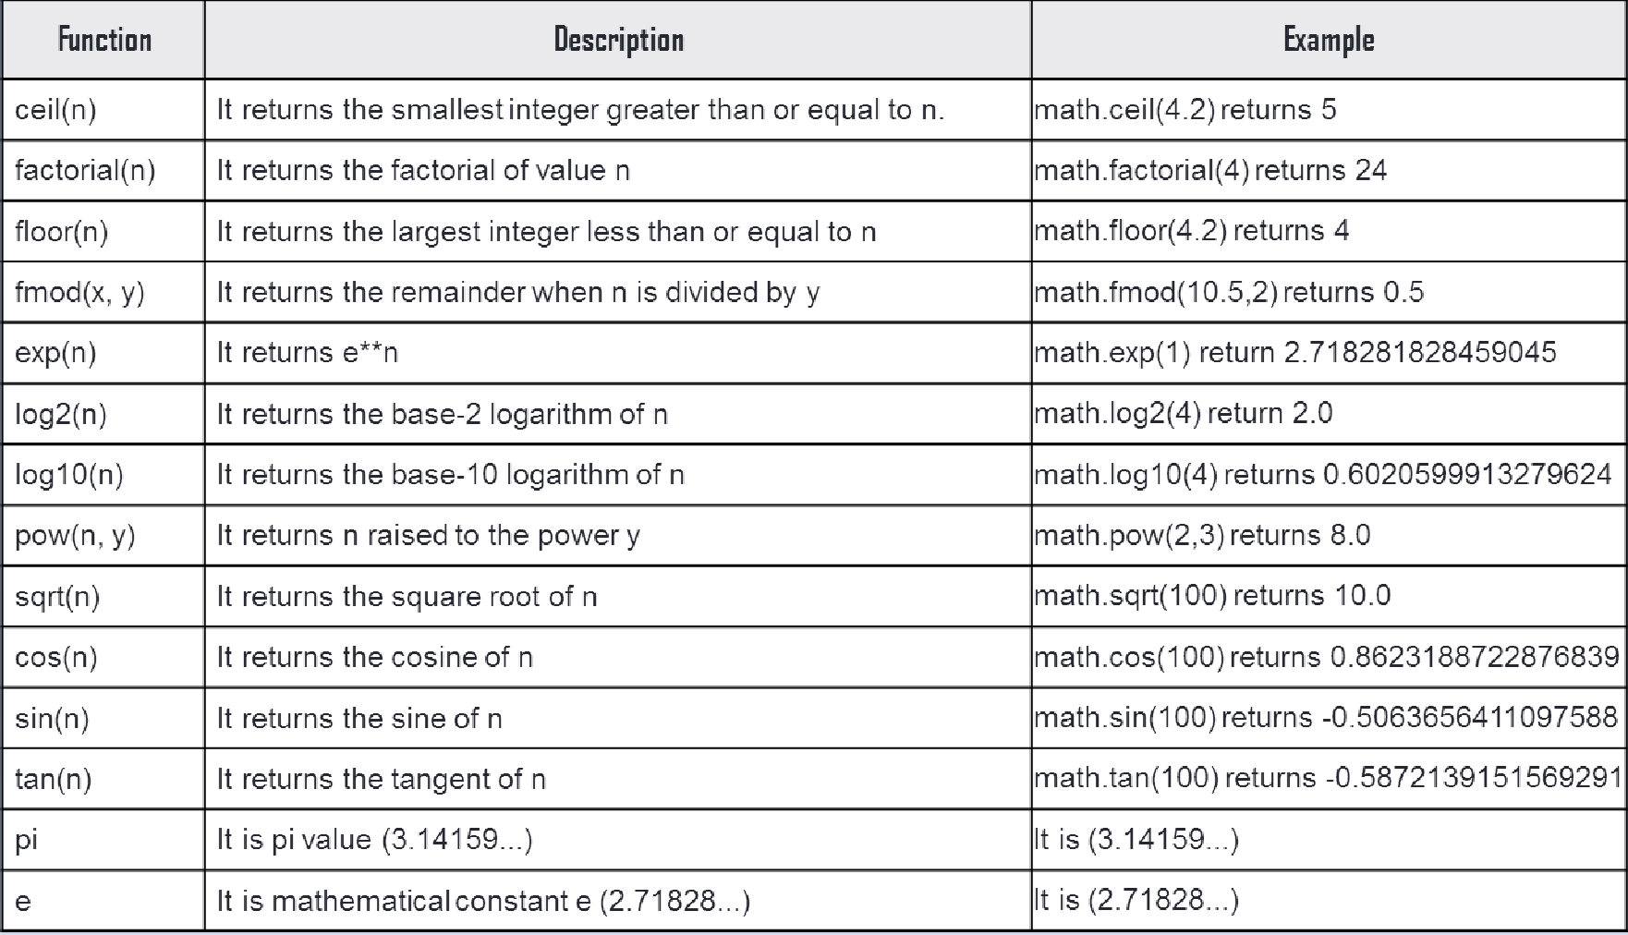
Functions using libraries
Functions available in Python Math Module

Slide 22
Functions using libraries (System defined function)
String functions:
String functions are available in python standard module.These are always availble to use.
For e.g. capitalize() function Converts the first character of string to upper case.
s="i love programming" r=s.capitalize()
print(r)
OUTPUT:
I love programming

Slide 23
Functions using libraries
String functions:
Method | Description
capitalize() | Converts the first character to upper case
casefold() | Converts string into lower case
center() | Returns a centered string
count() | Returns the number of times a specified value occurs in a string
encode() | Returns an encoded version of the string
endswith() | Returns true if the string ends with the specified value
find() | Searches the string for a specified value and returns the position of where it was found
index() | Searches the string for a specified value and returns the position of where it was found

Slide 24
Functions using libraries
String functions:
Method | Description
isalnum() | Returns True if all characters in the string are alphanumeric
isalpha() | Returns True if all characters in the string are in the alphabet
isdecimal() | Returns True if all characters in the string are decimals
isdigit() | Returns True if all characters in the string are digits
isidentifier() | Returns True if the string is an identifier
islower() | Returns True if all characters in the string are lower case
isnumeric() | Returns True if all characters in the string are numeric
isprintable() | Returns True if all characters in the string are printable
isspace() | Returns True if all characters in the string are whitespaces
istitle() | Returns True if the string follows the rules of a title
isupper() | Returns True if all characters in the string are upper case
join() | Joins the elements of an iterable to the end of the string
ljust() | Returns a left justified version of the string
lower() | Converts a string into lower case

Slide 25
Functions using libraries
String functions:
Method | Description
replace() | Returns a string where a specified value is replaced with a specified value
split() | Splits the string at the specified separator, and returns a list
swapcase() | Swaps cases, lower case becomes upper case and vice versa
title() | Converts the first character of each word to upper case
upper() | Converts a string into upper case
zfill() | Fills the string with a specified number of 0 values at the beginning

